Slide 1
Chapter 10: System Integration With Reusable Macros
Reuse Methodology Manual for System-On-Chip Designs
Notes:
This is the light cover slide option.

Slide 2

Chapter content
Integration Overview
Integrating soft macros
Integrating hard macros
Integrating RAMs and Datapath generators
Physical design
Figure.1: Integration of blocks

Slide 3
1- Integration Overview
We saw previously how to design a reusable individual block. Now, we will see how to assemble these blocks into the final chip.
The process of integrating the blocks and doing the physical design can be broken onto the following steps:
Selecting IP blocks and preparing them for integration
Integrating all blocks into the top-level RTL
Floorplaning and timing model generation
Synthesis and initial timing analysis
Physical synthesis and timing analysis with iteration until timing closure
Detailed route, timing verification and power analysis
Physical verification of the design

Slide 4
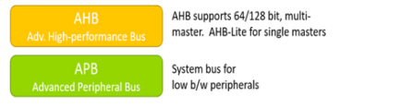
2- Integrating Macros
Problems in integrating IP
We do great job in decomposing the design well into blocks, but we find issue while integrating those blocks such as:
Low level interfaces do not work (e.g. handshake signal is inverted)
Misunderstanding of the block’s functionality
Functional bugs in the design
These problems can be easily fixed with the presence of the block designers and the system architect.
For an IP that is obtained from external source, some other problems that occur:
Someone needs to be familiar with the IP
Documentation is incomplete, thus understanding is harder
Interface of the IP does not match the interface of the system bus
Limited support is available from the IP provider
Figure.2: Standard system buses

Slide 5
2- Integrating Macros
Problems in integrating IP
Some purchased IPs need designed additional blocks to pass data to and from it.
The detailed handshake may differ as in figure.3 (e.g. one block may require “ready for data” signal from the target while the target expect “request for write” before sending data).
In higher level , blocks may have different kinds of transactions: posted writes, burst reads and interrupted transactions. These are more difficult to resolve.
Now let’s talk about Strategies for Managing Interfacing Issues..
Master
“Wait for slave”
Slave
“Wait for master
Figure.3: handshake conflict
Notes:
posted write is a computer bus write transaction that does not wait for a write completion response to indicate success or failure of the write transaction
Burst mode is a generic electronics term referring to any situation in which a device is transmitting data repeatedly without going through all the steps required to transmit each piece of data in a separate transaction.

Slide 6
2- Integrating Macros
Strategies for Managing Interfacing Issues
Some groups try to establish internal interfacing standards as it is hard to establish standards across the industry due to different designs’ power, performance and protocol needs.
Some steps are considered to mitigate the problem:
Plan the interfaces of external IPs and analyze them
Keep all the interfaces simple (e.g. interfaces include data read and ready for data signals)
Standardize on industry-standard buses (AMBA, Avalon, CoreConnect, STBus, Wishbone)
Large investment on the successfully implemented and previously interfaced IPs.
Document the experience of using IPs.

Slide 7
2- Integrating Macros
Interfacing Hard Macros
Power, clock tree routing and scan insertions are done during chip-level integration for soft macros. This ensures consistency and compatibility. But for hard macros, these are done during macro design. Thus, using it should be very well planned as follows:
Power and ground should be provided appropriately to the macro
Integrating testing structures into the overall chip design to facilitate debugging of the macro.
Considering the internal clock tree of the hard macro.
Guideline – Hard macro’s clock pin should be separate (although clock source could be the same) to allow clock delay tuning and matching.
How to select external macros?..

Slide 8
3- Selecting IP
Hard macro selection
Well documented macro that contains functionality, interfacing, timing, interfacing and verification details.
Ensure completeness of design and verification environment.
Design should be silicon proven to ensure robustness of the design.
Physical design details to avoid blocking of routing and producing unacceptable delays.
Soft macro selection
Well documented macro that contains functionality, interfacing, timing, how to configure and verification details.
Robustness of verification environment.
Robustness of design by proving in silicon.
Ease of use and interfacing to the rest design.

Slide 9
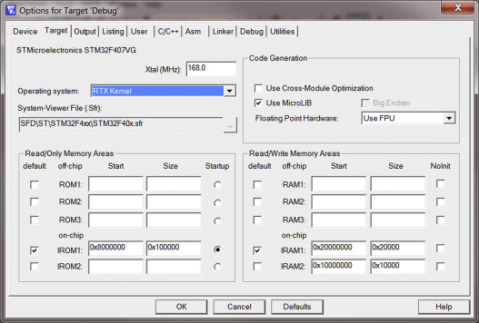
3- Selecting IP
Soft macro configuration
Many soft macros are configurable setting to generate complete RTL for desired configuration.
Some IP vendors provide documents or configuration wizards to ensure consistency and correctness for the IP configurations as shown is figure.4.
Synthesis of soft macros
Performing initial synthesis with the target library gives good indication for timing, area and power goals of the design.
Figure.4: Configuration wizard

Slide 10
4 – Integrating Memories
There are memory compilers that produces functional, timing models and physical information to fabricate the memory.
Memory design has previously mentioned issues in hard macros and some additional issues such as:
Selecting RAM configurations: (single port or multi port), (fast or low-power), (synchronous or asynchronous)
Timing critical design for asynchronous type. Recommending synchronous type.
Checking the aspect ratios to avoid blockage problems.
Data retention problems that are not tested by the BIST techniques.

Slide 11
5- Physical design
We aim to make the SoC design achieve timing closure with few iterations and as quick as possible.
We will discuss the major activities for this process:
Preparation of the design by performing block-level then chip level synthesis.
Physical placement by doing detailed floorplanning and re-placement until timing goals are met
Timing closure by adding clock buffers and performing detailed routing
Physical verification by running final checks prior to tape-out
These are discussed in detail later.

Slide 12
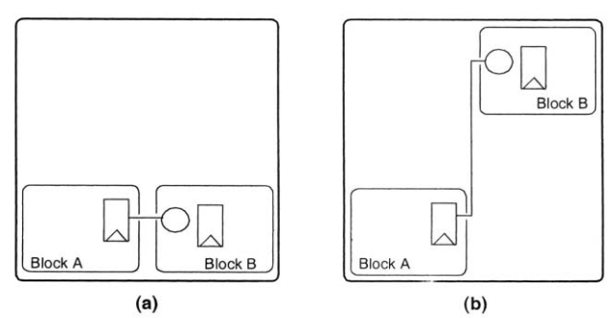
5- Physical design (Design Planning and Synthesis)
Design Planning
At the very start, die size, number of I/O pads and power dissipation should be determined.
After determining the design blocks, initial floor-planning and rough placement are done to get information on the power and clock distribution.
Selecting the wire models by knowing the registered inputs and outputs for proper timing calculations figure.5.
Synthesis
Knowing these initial physical design information, we can now synthesis
each block independently using wire load models and time budgets.
Once each block is meeting time, we do chip (top level) synthesis.
Inputs to the top-level synthesis may be:
Timing budgets and wire load models from design planning stage
RTL for synthesisable blocks
Synthesis models for hard macros and memories
Any libraries required such as DesignWare Foundation library
Top-level RTL
Figure.5: Critical placement
Notes:
Point 4 is the beginning of synthesis

Slide 13
5- Physical design (Design Planning and Synthesis)
Synthesis
If clock gating is needed, power compilers are used to convert mux-hold flops into gated clock.
After inserting test structures, final timing analysis is performed. The synthesised netlist is now ready for detailed floorplanning.
List of false paths should be completely correct and well revised not to set a wrong false path which will not be synthesisable or synthesis false path which will make the tool work hard to optimize it. (recommended to avoid false and multicycle paths).
Equivalence check
Use functional verification tools can be used to prove the equivalence of the RTL and synthesised netlist.
DFT preparation
Scan insertion preparations (scan ports and scan signals) for the DFT tool (if used). Then an ATPG* tool can be used to generate scan test vectors.
*ATPG: Automatic Test pattern generator
Notes:
Point four is equivalence check
Point five is DFT preparation
Is not the fourth point named formality??
Automatic Test pattern generator: ATPG

Slide 14
5- Physical design (Physical Placement)
Floorplanning and Power Planning
During synthesis, we can never have accurate wire model (what was inserted was estimated).
After the DFT insertion we can fix if “we have not already”:
Block placement
I/O pad placement
Placement of I/O cells for each block
Power mesh initial routing can be done taking into consideration that routing resources (metal layers and chip area) of the power could be used for signals.
Often the chip will have different power supplies (and power rings) for I/O and core logic especially if they run off at different voltages.
Notes:
Placement and Physical scan insertion from point five

Slide 15
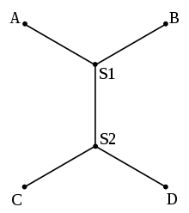
5- Physical design (Physical Placement)
Placement and Physical Scan Insertion
Timing-driven placement technology is provided now. To use it effectively we need to provide to the physical synthesis:
Technology file that models the interconnect parasitic
Reasonable and accurate timing constraints
Comprehensive physical library for all cells undergoing placement
A design which meets tool specifications and is optimization-friendly
Estimation of the capacitance of the metal interconnect relies on the technology file. They affect the delay of the gate (total capacitance seen by the gate). We should consider worst case so that the final routing is no worse.
Estimation for the actual length can be done assuming Steiner route (which is
optimal route). Another routing techniques can be considered if area is congested.
Report of estimated capacitance is generated after completing the placement.
Figure.6:Steiner Route

Slide 16
5- Physical design (Physical Placement)
Deriving Constraints
Well-derived constraints can make synthesis and placement run faster and converge with fewer iterations. Over-constraining the design can take much longer time for the too; to achieve those hard constraints.
False paths should be pre-determined before placement.
Flat vs. Hierarchical Placement
Some designs (e.g. microprocessor) are designed with strict hierarchy, that includes:
Location of each major block is identified early
Pin locations for I/O of each block is assigned
Some room between blocks is reserved for top-level routing
Top level routing is done before blocks placement
Second approach is to do completely flat place and route where:
Location of each major block is identified early
Timing constraints are developed for the design based on the information from the steps above and the entire design is placed as a unit
Detailed routing is performed on the chip a single unit.
Notes:
This is the beginning of the Deriving Constraints
From point 3 Flat vs. Hierarchical Placement

Slide 17
5- Physical design (Physical Placement)
Time Convergence and Iterations
One hope to meet timing after the initial placement but some timing problems may occur due to timing constraints and design itself. These problems are:
Unlisted false path and inappropriately placed critical paths. Solve this problem by updating constraints and re-run physical synthesis.
Timing is close but not passing. Solve this problem by changing the constraints and re-run placement.
If the timing is still not met, change the RTL by adding pipeline stages. Then repeat the whole flow.
Now let’s move from physical placement to time closure..
Notes:
Time convergence and iterations from the beginning

Slide 18
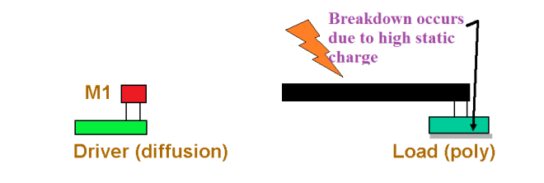
5- Physical design (Time Closure)
Clock Tree Insertion
After placement meets timing and before routing, we must balance the insertion delay from clock source to leaf cells by buffering clock(s). They are critical to minimize clock skew. Hence, they are routed first. Problem occurs due to large number of buffers needed, therefore, reserved area for the buffer near flops groups
Detailed Routing
After routing clock, we can do detailed routing ensuring that we comply process’ rules for antennas. Otherwise, we must return after routing to fix any violation. Figure.7
Parasitic extraction
We can calculate actual load of each metal interconnect segment using
3-D extraction engine* which is mor accurate than statistical interconnect
load model used in synthesis.
Due to deep sub-micron technologies, older wire models failed due to increasing the resistance (thinner wires) and cross-talk effect (narrower routing).
*3-D extraction engine: coupling capacitances were introduced in three dimensions. Wire-to-wire (same layer), wire-to-substrate, wire-to-wire (different layers).
Figure.7: Antenna effects
Notes:
Clock Tree insertion from the beginning
Point 2 is detailed routing
Point 3 is parasitic extraction

Slide 19
5- Physical design (Time Closure)
Static Timing Analysis
Timing reports are generated with static timing analysis tool showing violated constraints.
Some solutions for those violations are increasing drive strength, adding buffers or restructure logic. This is done lately automatically with EDA tools.
Timing Fixes
Some hold timing violations are expected at this point as well as some remaining clock tunning due to estimated routing models.
We fix clock and long paths first if there are few fixes required. Else, we would have to go back and readjust timing constraints, re-optimize and go back through place and route. Then re-iterate until timing is met.
Hold timing is fixed by inserting buffers in the fast paths.
Notes:
Static time analysis from beginning
Timing fixes from point 3

Slide 20
5- Physical design (Verifying the Physical Design)
Checking Power
The last major step is verifying that the physical design is correct and in compliance with the design rules for target silicon process.
We can estimate voltage drop across power meshes using power analysis tools.
Power dissipation tools are used to get final estimation of power dissipation.
DRC, LVS and Antenna
DRC* verifies that the design does not violate any physical design rules.
For full-custom designs, this can involve many iterations. But in the standard model of reuse, full-custom designs are imported after being verified.
Typical problems are caused in libraries or by interface problems between standard cells sections and any hard blocks that have been imported.
LVS** compares the physical implemented design to the gate-level netlist. It extracts a post-layout netlist back from the physical design then it is compared to pre-layout netlist.
Finally, we check for any antenna violations that might have escaped then manually fix this problem. Then formal verification is done to check equivalence with the intended function. *DRC: design rule check **LVS: layout vs schematic
Notes:
Checking power in the point 2
DRC, LVS and Antenna from point 4

Slide 21
Summary
Physical design is a challenging and complex task. The algorithm used by tools is very complex.
There is much the designer can do to reduce the risk of runaway schedules in physical design. Once placement is successful, the rest of the design process is straightforward and should require few iterations.
By carefully choosing a set of simplifying assumptions, mainly in how we estimate routing delay, this loop can be made relatively fast (hours instead of days).

Slide 22
Thank you!

